Slide 1
Capacity cuts bought time, not competitiveness
Volkswagen Group · Strategy case
VW's next move on unit cost
Presented by
Ben An · Dan Mosu · Kai Clancy · Kate Bloom · Priyanka Govani
October 2026
Notes:
0:30. Open with the question: VW has cut capacity, so why is its own brand still earning 2.4% against a 6.5% target? Three parts: why the gap persists, what we recommend, how it is delivered. Roles: split the speaking across the five authors before rehearsal.

Slide 2
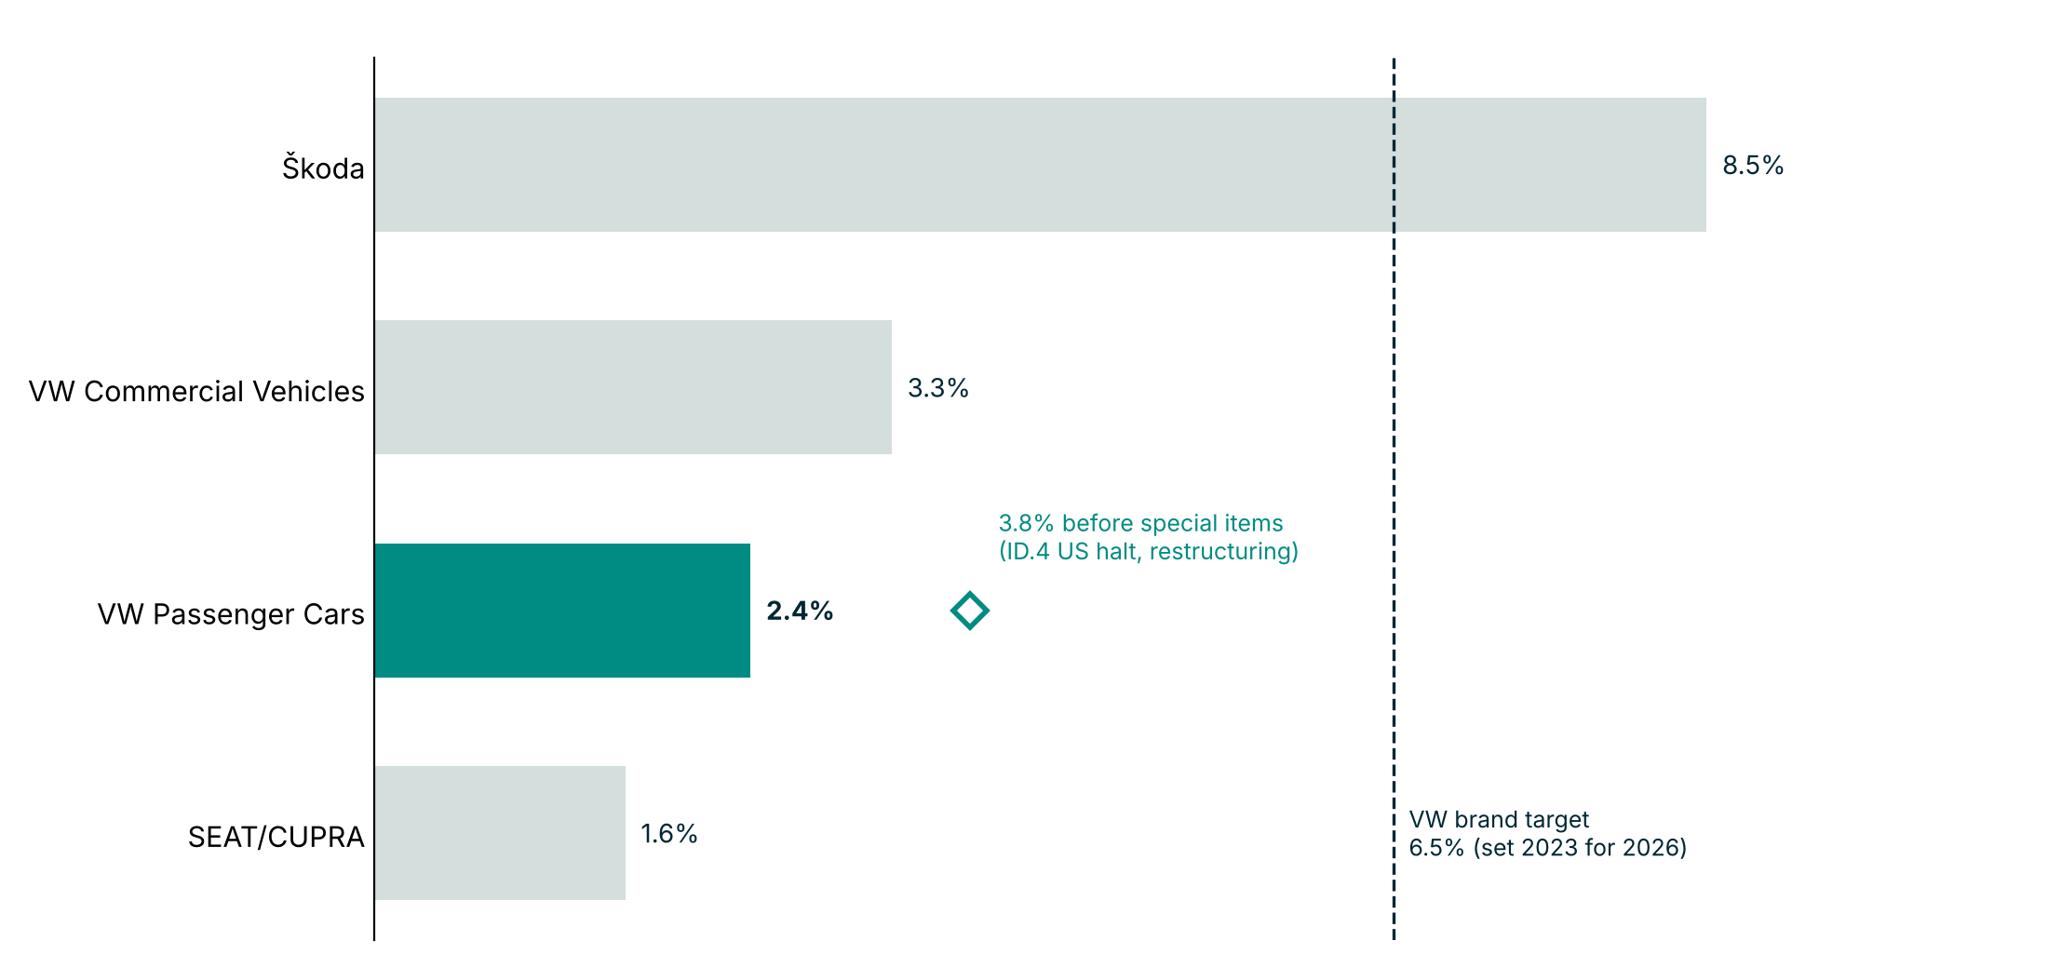
VW's own brand earns 2.4% against a 6.5% target, while Škoda earns 8.5%
WHY · The margin gap
4.1 pts
below target as reported (2.7 pts before special items)
3.5×
Škoda's margin versus VW Passenger Cars
Source: VW press release no. 68/2026 (24 Jul 2026); 6.5% target from VW newsroom, 2023
1
Notes:
1:00. State the gap plainly: 2.4% reported, 3.8% before special items, against a 6.5% target for the VW brand. Škoda earns 8.5%, so the group can do better in the same market. Caveat if asked: the 6.5% target was set in 2023 and we have not checked whether it was restated.

Slide 3
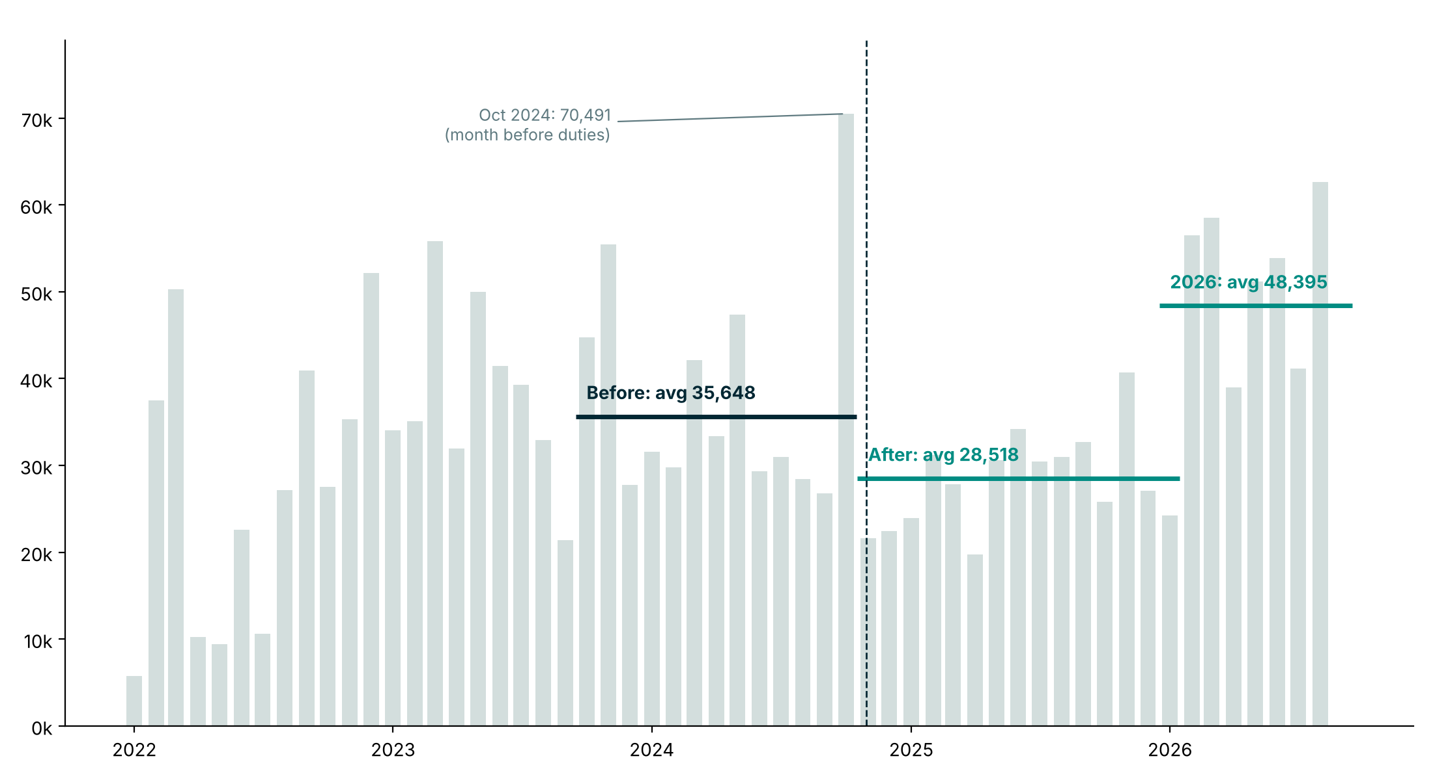
Chinese EV imports dipped 20% after the duties, then reached 36% above their old level
WHY · Chinese imports
+36%
2026 imports versus the 12 months before the duties
35,648 → 28,518 → 48,395
cars a month: before, after the duties, 2026
Source: Eurostat Comext DS-045409, CN8 87038010 and 87038090, EU member states; duties from 30 Oct 2024
2
Notes:
1:15. Walk the line: fall after the duties started on 30 Oct 2024, then a recovery past the old level. Averages exclude October 2024, the transition month. The data covers all China-origin makers, including Western brands built in China, not BYD alone. The duties slowed imports for about a year, not for good.

Slide 4
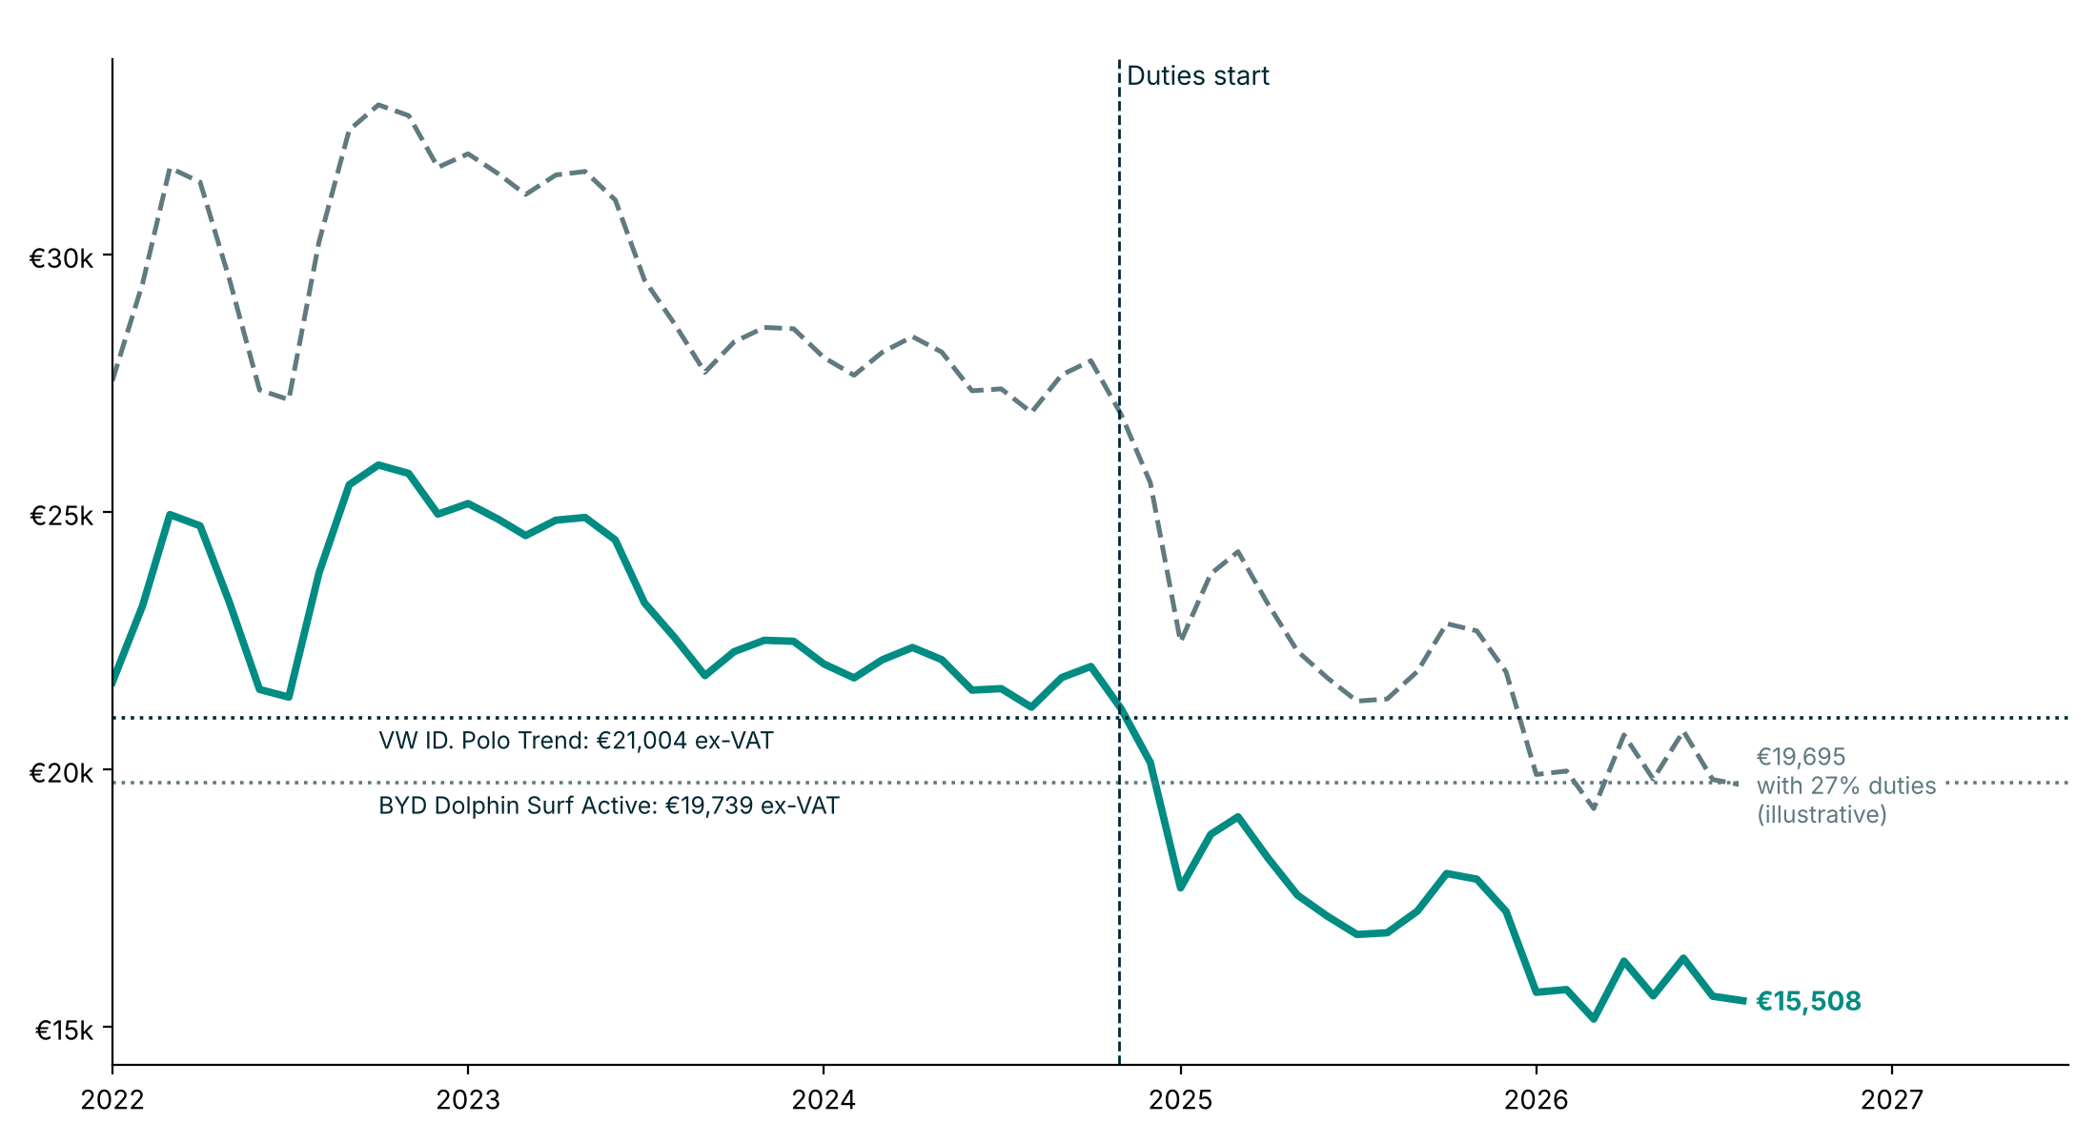
Even with duties, the average Chinese import lands near VW's entry price
WHY · Price
€19,695
latest 3-month import value with 27% duties added
€21,004 VW ID. Polo Trend, ex-VAT
€19,739 BYD Dolphin Surf Active, ex-VAT
Source: Eurostat Comext; VW and BYD websites. 27% is BYD's rate; value excludes shipping and dealer margin
3
Notes:
1:30. Average value per car fell 29% from €22,018 before the duties to €15,593 in 2026. Adding 27% duties gives about €19,700, which is €1,309 below the VW ID. Polo Trend and €44 below the BYD Dolphin Surf. Caveats: the 27% is BYD's rate (Tesla 7.8%, Geely 18.8%, SAIC 35.3%), customs value excludes shipping and dealer margin, and we have not confirmed whether the VW price is before any subsidy. AUDIENCE CHECKPOINT 1: "Which would you buy at these prices, and why?" Take one or two answers, then move to the Big Idea.

Slide 5
Announced savings are not closing VW's margin gap while Chinese imports return, so VW must cut entry-segment unit cost through shared platforms and external battery and software partners.
WHAT · The Big Idea
One program, one target: lower cost per entry car, where Chinese imports compete on price.
4
Notes:
1:00. Pause on this slide. This is the one sentence we want the board to remember. WHY ended with three facts: a 4.1 point margin gap, imports 36% above their old level, and import prices near VW's entry price. The Big Idea answers all three with one move: take cost out of every entry car. The rest of the talk tests this against the alternative and shows how to deliver it.

Slide 6
Two options: continue as announced or add a unit-cost program
WHAT · The options
What the board asks
Option A: Continue as announced
Option B: Add a unit-cost program
Margin impact
About €18B a year reported saved, yet 2.4% margin
Est. €490–2,090 per entry car: 0.2–1.2 margin points, 4–29% of the gap
Capital need
Committed: up to USD 5.8B for Rivian by 2028; R&D €19.4B a year
Payback ceiling €0.6–4.2B by 2030; actual spend to size in phase 1
Union feasibility
Labour savings of €1.5B a year by 2030 already reported
Needs Works Council and IG Metall alignment
Speed
Savings accrue through 2030
Phased 2026 to 2030, with gates
Source: VW Annual Report 2025; releases 68, 69/2026. Add-program figures: team estimates (notebook 3.5, 3.6)
5
Notes:
1:30. Two options only. Option A is what VW has already announced. Option B adds one unit-cost program on top. Compare on the four criteria the board cares about: margin, capital, union feasibility and speed. Capital: option A already carries the committed partner spend, up to USD 5.8B for Rivian by January 2028 (about USD 3.3B paid by mid-2025, up to USD 2.5B more on 2026-27 milestones; Annual Report 2025, PDF p86) and R&D of €19.4B in 2025 (p119). That spend is not extra under option B. VW does not publish what a unit-cost program would cost, so the figure on the slide is a payback ceiling, not a forecast: the most the program could cost and still pay back by 2030 (annual saving of EUR 147M-1,043M x 4 years = EUR 0.6-4.2B). Phase gates should release money only while projected cost stays under it. Program estimate: the four lever ranges sum to EUR 701-2,607 per car, less a 20-30% overlap haircut = EUR 491-2,086; x 300,000-500,000 entry cars a year = EUR 147M-1.0B a year; divided by EUR 86.6B VW Passenger Cars revenue = 0.17-1.20 margin points, or 4-29% of the 4.1-point gap. Entry cars alone do not close the gap, so say that the approach must extend to higher-volume models. All assumptions are labelled in notebook section 3.6 and in the reasoning document. The next slide shows why option A alone is not enough.

Slide 7
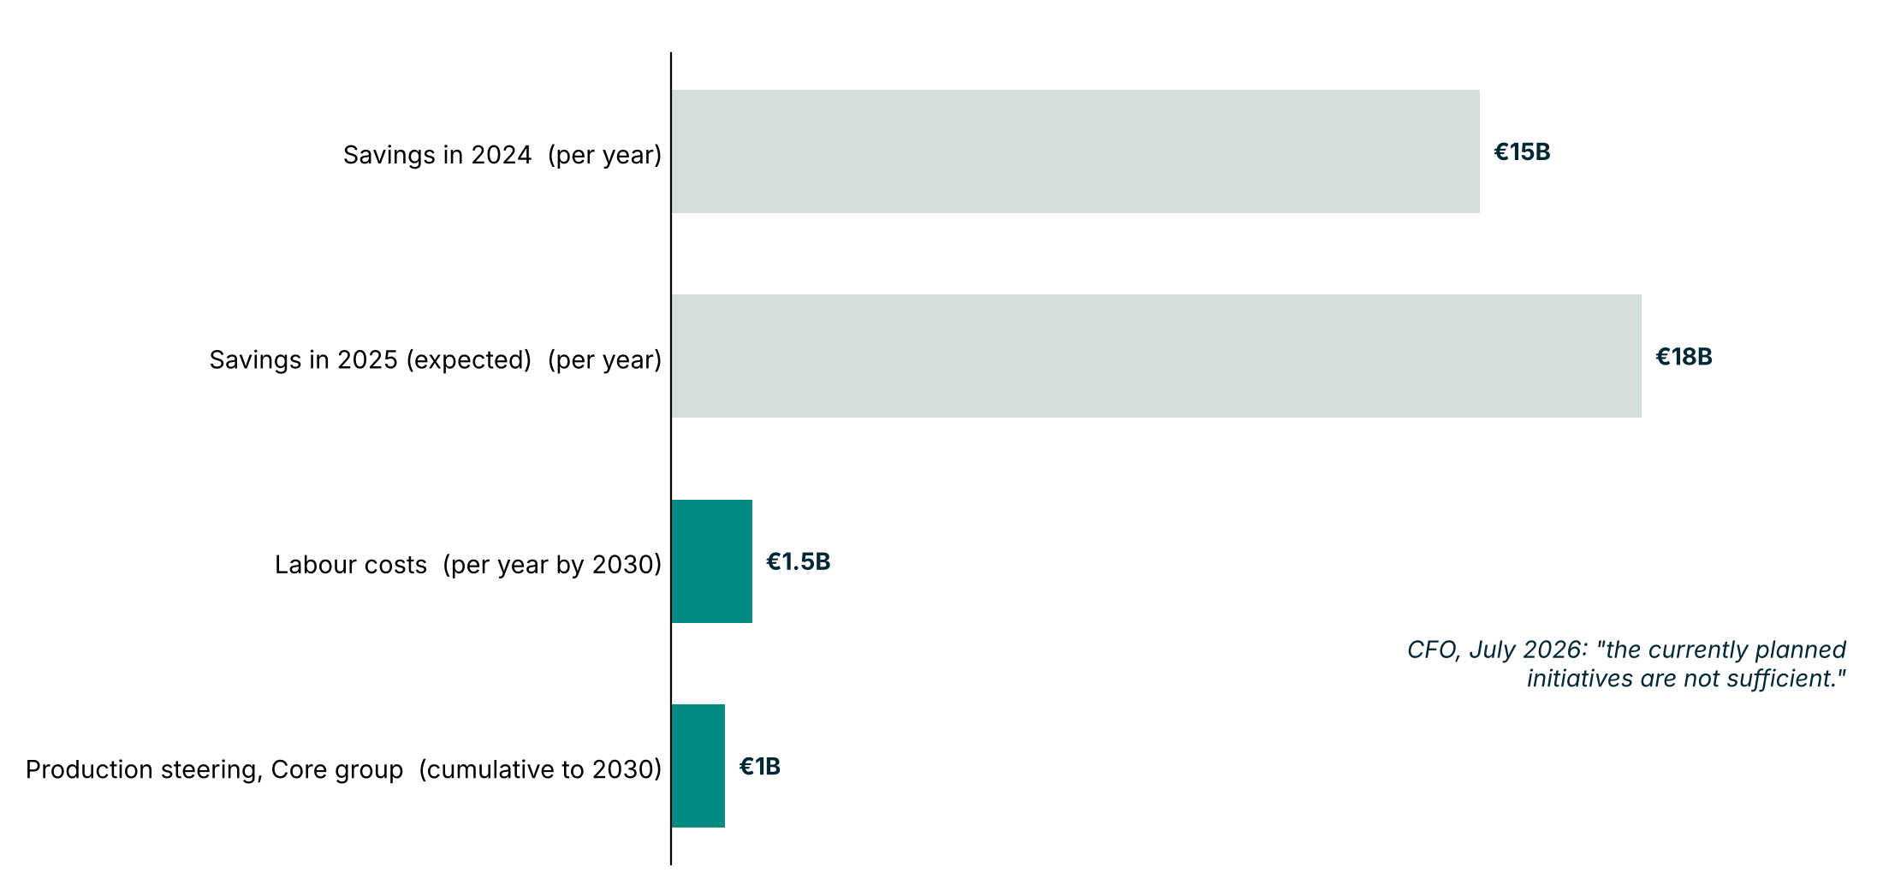
Announced savings alone do not close the gap: about €18B a year reported, yet the Group margin is 3.8%
WHAT · The evidence
€18B
a year saved in 2025 (expected), per press reports
3.8%
Group operating margin, H1 2026
Source: electrive 17 Feb and 18 May 2026 (press); VW releases 68/2026, 69/2026. Bases differ; figures are not additive
6
Notes:
1:00. This is the evidence behind option A. Reported savings are large: €15B in 2024 and €18B expected in 2025, plus €1.5B a year in labour savings by 2030 and €1B of production savings to 2030. Yet the Group margin is 3.8% and the VW brand 2.4%. Do not add the bars: the bases differ (per year, per year by 2030, cumulative). The savings figures come from press reports, not VW releases, so say so. AUDIENCE CHECKPOINT 2: "If these savings are real, why has the margin not moved? What is still missing?" Take one answer, then turn to how the unit-cost program delivers.

Slide 8
Four levers can take cost out of every entry car
HOW · The levers
Lever
What public sources show
Est. € per car
1 · Shared platform
Four models, three brands, one platform (MEB+), in production since early 2026
€84–281
2 · External software partner
Up to USD 5.8B planned for the Rivian venture by 2028; CARIAD lost €2.2B in 2025; zonal architecture from 2027
€49–121
3 · Lower-cost battery chemistry
Entry ID. Polo already has a 37 kWh LFP pack; PowerCo unified cell planned for up to 80% of EV models
€305–1,102
4 · Sourcing
UBS (2023): BYD Seal 25–35% cheaper to build than European rivals; VW's 2025 cost of sales outgrew revenue
€263–1,103
Sources: VW Annual Report 2025; BNEF 2025; UBS 2023 (press). € per car: team estimates, not published by VW
7
Notes:
1:30. These four levers all attack one number: cost per entry car. Each row shows what public sources confirm. Sources by row, all PDF page numbers of the VW Annual Report 2025: platform p8 and p143; software p86 (Rivian, up to USD 5.8B by Jan 2028), p460 (CARIAD operating result -2.2B), p9 (zonal architecture first used in the ID. Every1, launching 2027); battery p143 (unified cell, LFP and NMC, up to 80% of models) and electrive 15 Dec 2025 (ID. Polo small pack is 37 kWh LFP); sourcing p118 (cost of sales grew faster than revenue on higher material costs) and the UBS 2023 BYD Seal teardown as reported in the press (check the UBS report before quoting). Per-car figures are team estimates from notebook section 3.5, not VW data. Platform EUR 84-281: Group R&D ratio 6.7% (Annual Report p119) x ID. Polo ex-VAT price EUR 21,004 = about EUR 1,407 of R&D per car, x 30-50% platform share (assumption) x 20-40% cut from sharing across four models (assumption). Software EUR 49-121: CARIAD 2025 operating loss EUR 2.18B (p458) / 8.98M Group deliveries (p97) = about EUR 243 per car, x 20-50% avoided with an external partner (assumption). Battery EUR 305-1,102: 37 kWh pack (electrive) x pack cost USD 99-131/kWh (BNEF 2025 EV pack average USD 99; high end is China USD 84 x 1.56 for Europe, derived, verify) x 10-25% cost reduction from chemistry and the unified cell (assumption; VW's own aim is up to 50% in the entry segment, Power Day 2021) / USD per EUR 1.10-1.20 (assumption, check the ECB rate). Sourcing EUR 263-1,103: entry price ex-VAT EUR 21,004 as a cost proxy x UBS 2023 cost gap to the BYD Seal of 25-35% (via press, check the UBS report) x 5-15% of that gap closable by re-tendering (assumption: BYD makes about 75% of its parts in-house, which re-tendering cannot copy). VW does not publish unit costs by lever; they sit in internal cost models and supplier contracts, so phase 1 sizes them with VW's own data. The ranges overlap, so do not add them.

Slide 9
Three phases deliver the program by 2030, each released at a gate
HOW · The roadmap
PHASE 1 · 2026–27
PHASE 2 · 2027–28
PHASE 3 · 2029–30
Size and decide
Launch
Scale
Size each lever in € per car
Select partners
First entry model on the shared platform
Re-tender parts
Roll out across entry models
Combine with 2030 labour savings
Gate: cost target per car agreed
Gate: cost per car at target
Gate: margin on path to 6.5%
Proposed by the team. 2030 labour savings of €1.5B a year as reported by electrive, 18 May 2026
8
Notes:
1:00. Three phases, each with a gate so the board releases money only when the last phase delivered. Phase 1 sizes the levers and picks partners. Phase 2 launches the first entry model and re-tenders parts. Phase 3 scales across entry models, alongside the labour savings already reported for 2030. Dates and gate thresholds are our proposal, not VW plans.

Slide 10
The program needs the Works Council, IG Metall and partners aligned from day one
HOW · The people
Works Council and IG Metall
Battery and software partners
Management and Supervisory Boards
Concern: jobs and plant capacity.
Concern: control of technology and data.
Concern: margin recovery and capital discipline.
Ask: build the program on the labour savings already reported.
Ask: agree governance and cost targets before launch.
Ask: release funds phase by phase, at each gate.
Stakeholder concerns are the team's assessment of the audience
9
Notes:
0:45. Execution risk is mostly about people. Works Council and IG Metall care about jobs and capacity, so tie the program to the labour savings already reported rather than adding new cuts. Partners need clear governance over technology and data. The boards want margin recovery with capital discipline, which the gates in the roadmap provide. If asked about a stress test, say it is still to do: price floor changes and BYD building cars in Hungary would both shift the picture.

Slide 11
Approve the unit-cost program
THE DECISION FOR TODAY
1
2
3
Adopt entry-segment cost per car as the single target
Release phase 1 to size the levers and select partners
Set gates that release funds only against results
Questions: what would you need to see before approving phase 1?
10
Notes:
1:00, then 3:00 of questions. Close by returning to the Big Idea: announced savings have not closed the gap, imports are back, so cut cost per entry car. Three asks: adopt the target, release phase 1, set gates. Open the questions with the prompt on the slide. Likely questions: where do the savings figures come from (press reports; VW's own numbers needed), was the 6.5% target restated (not checked), and what does each lever save per car (not yet sized).

